Slide 1


SPANISH PROSODY
Hispanic Linguistics Symposium 2019
UTEP
10/25/2019
Workshop files:
https://github.com/sanchezal/IntonationWorkshop
AN INTRODUCTION TO THE ANALYSIS OF INTONATION
Covadonga Sánchez-Alvarado
Winona State University
Covadonga.snchezalvarado@winona.edu
https://b.socrative.com/login/student/
ROOM: COVADONGA52

Slide 2
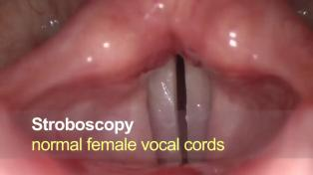
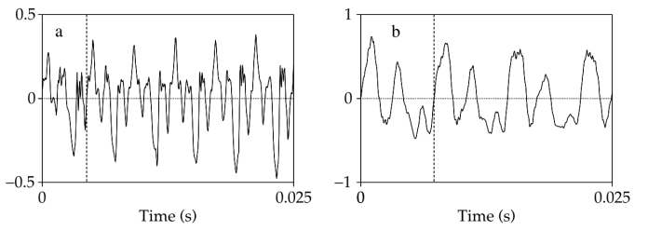


INTONATION
F0 → PITCH
Vocal fold vibration measured in Hz (hertz)=periods per second.
[ɛ]
F0= 226 Hz
[u]
F0= 138 Hz
Gussenhoven (2004)

Slide 3

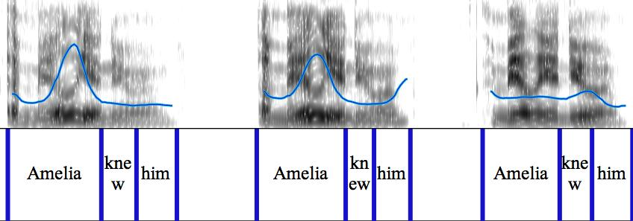

PITCH TRACKS
TIME
Hz
Boersma and Weenink (2009)
Notes:
Any phonetic analysis software can be used to analyze the pitch contour. Here I used Praat.

Slide 4



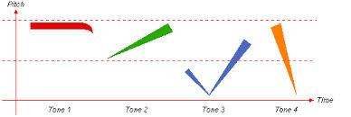
TONAL LANGUAGES
INTONATION LANGUAGES
F0 is used at the lexical level
F0 can be used as a correlate of stress.
Ánimo, animo, animó
Intonation is used at the sentence-level to express semantic-pragmatic meanings.
Ánimo
¿Ánimo?
¡Ánimo!
mā | Mother
má | Hemp
mǎ | Horse
mà | Scold
Hualde (2003), Gussenhoven (2004)
Notes:
we could expand these with many words too but the contour stays the same

Slide 5
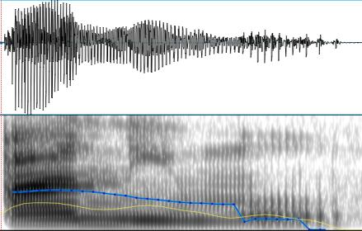
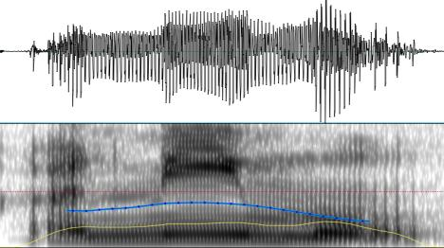
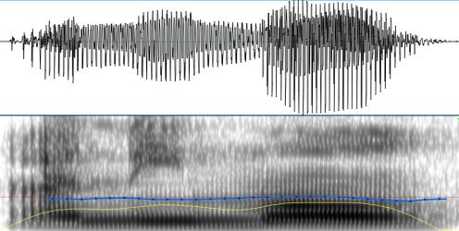
INTONATION LANGUAGES
Ánimo
Animo
Animó
Notes:
we could expand these with many words too but the contour stays the same

Slide 6
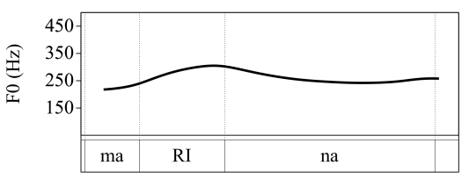
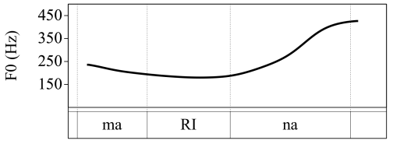
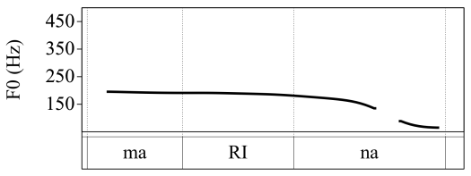
Vocative/Call
Neutral question
Declarative
Notes:
So here’s a quick intro to what we mean by intonation. I’m going to play you three sound files. They are all a recording of the word Marina, but as you’ll hear the pitch or intonation of the word is different. Use your eyes and ears to decide which recording (1, 2, 3) matches which picture

Slide 7
Vocative/Call
Neutral question
Declarative
Notes:
So here’s a quick intro to what we mean by intonation. I’m going to play you three sound files. They are all a recording of the word Marina, but as you’ll hear the pitch or intonation of the word is different. Use your eyes and ears to decide which recording (1, 2, 3) matches which picture

Slide 8
GOALS
Introduce to the Autosegmental-Metrical framework.
Review different elicitation methods.
Consider some of the difficulties that may be encountered when examining pitch tracks.
Present the Sp_ToBI system, for the annotation of intonational contours, and practice labelling contours.
Discuss some of the challenges found in the study of intonation.

Slide 9
ANALYZING INTONATIONAL CATEGORIES

Slide 10
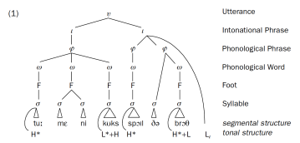
MODELS: AUTOSEGMENTAL-METRICAL
Phonological analysis of contrastive units which, combined, result in the different possible intonation contours in a language.
Autosegmental: separate tiers for segments and tone
Metrical: elements in those tiers are contained in a hierarchically organized set of phonological constituents
Tone Bearing Units
Pierrehumbert (1980), Gussenhoven (2004), Hualde (2003)
Notes:
Tones are independent of segments although there is connections: tones need segmental material to be realized

Slide 11
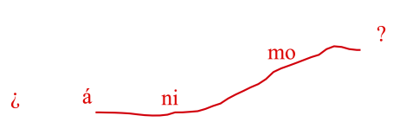
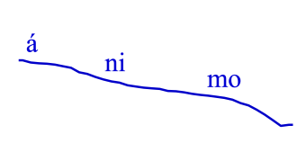
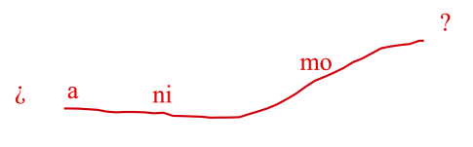
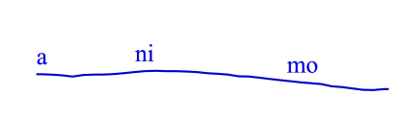
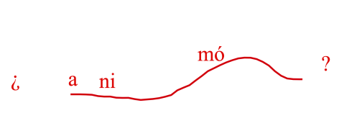
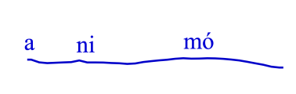
Tone Bearing Units (TBUs)

Slide 12


TBU
TBU
TBU

Slide 13
DECIDING ON TONAL CATEGORIES
Jun & Fletcher (2014)
NARROW TRANSCRIPTION
BROAD TRANSCRIPTION
Description of the F0 contour
Distinctive features that result in categorical differences
ToBI systems
Tonal levels
Tonal complexity
Diacritics
H
L
!H
M
ˆH
LH
HL
LHL
HLH
LM
* (e.g. L+H*)
< (e.g. L+<H*)
> (>H*)
ː (prolonged)
- (ip)
% (IP)

Slide 14
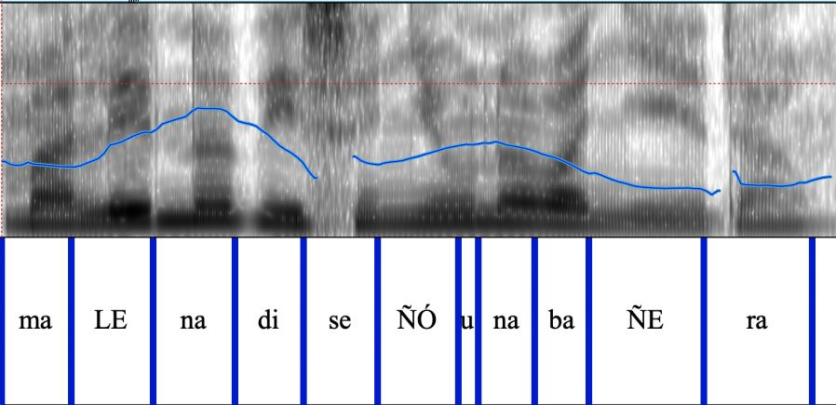
Starts mark a metrically strong syllable and the tone associated with it
<H*
<H*
L*

Slide 15
Leading (T+) and trailing (+T) tones account for the other movements
L+
<H*
L+
<H*
L*

Slide 16
Tonal movements at the end of an intonational phrase
<H*
L+
<H*
L*
L%
L+

Slide 17
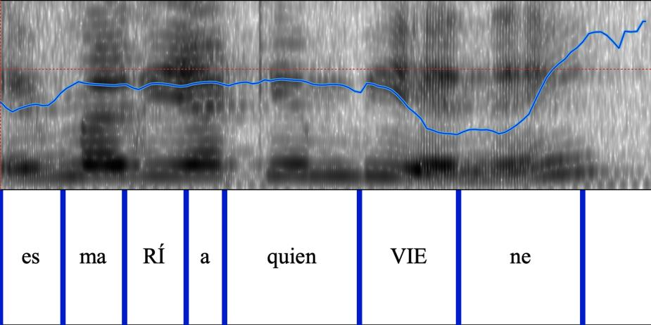
L*
+H
H*
H*
+L
H%

Slide 18
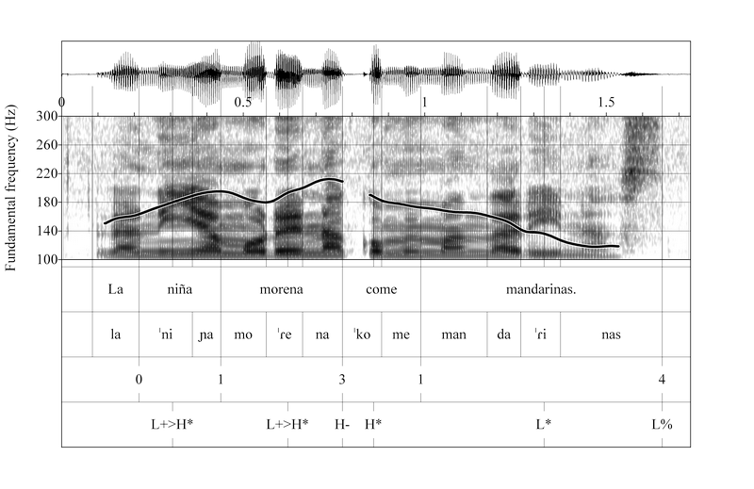
Hualde (2003)
Stressed syllables of content words (TBUs) → Pitch accents: (T+)T*/T*(+T)
Nuclear: last syllable
Pre-nuclear: all the preceding syllables

Slide 19
Hualde (2003)
The edge of intonational phrases → Boundary tones
Intermediate: intermediate phrases (ips): T-
Final: Intonational phrases (Ips): T%

Slide 20
Hualde (2003)
Nuclear pitch accent + Final boundary tone: Nuclear configuration

Slide 21
ToBI systems
Tones and Breaks Indices systems.
Language-specific annotation systems based on the Autosegmental-Metrical framework.
Labels (L o H) are used to described tonal movements at
Stressed syllables in tone bearing units
Non-final: pre-nuclear
Final: nuclear
The edge of intermediate (-) or intonational phrases (%)

Slide 22
PHONOLOGICAL VALUE
Relationship between the phonetic realization (or certain aspects of it) and the meaning conveyed through it, and contrast with other meanings.
Semantic nuances are sometimes hard to identify
Another difficulty: identify important functional units in the continuum of an intonational contour

Slide 23
ELICITING DIFFERENT INTONATIONAL CONTOURS

Slide 24
COLLECTION METHODS
Reading
Discourse Completion Task
Story-telling
Map tasks
Interviews
SPONTANEOUS
Fully understand form and meaning in context
Identify surface categories
Examine contextual variation
Phonological analysis
CONTROLLED
Notes:
It is very important to start off with controlled speech and that even though we want to represent real speech as best we can we have to be a little "patient" with intonation and sort things out BEFORE we get our hands dirty with spontaneous speech.

Slide 25

FINDING INTONATIONAL CATEGORIES
Underlying pitch accents and phonetic realization
For a language with stress:
Create three-word declarative sentences
Avoid breaks between words
Avoid stress/accent clashes (e.g. lavó víboras)
Bárbara lavaba monedas Lorena Lorena lavaba víboras
Lorena lavaba monedas Lorena lavaba monedas Lorena lavaba monedas
Salomón lavaba monedas Lorena devolvió monedas Lorena lavaba camarón
2) Increase the number of unstressed syllables before and after a stressed syllable
Sss sSs sSs
sSs sSs sSs
ssS sSs sSs
sSs Sss sSs
sSs sSs sSs
sSs ssS sSs
sSs sSs Sss
sSs sSs sSs
sSs sSs ssS
Jun & Fletcher (2014)

Slide 26
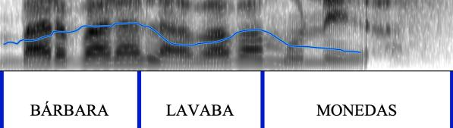
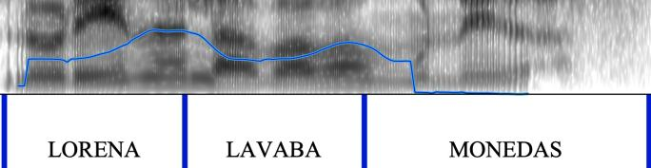
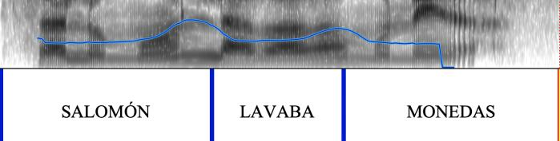
S
Sss sSs sSs
sSs sSs sSs
ssS sSs sSs

Slide 27
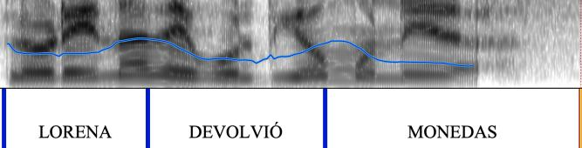
V
sSs Sss sSs
sSs sSs sSs
sSs ssS sSs

Slide 28
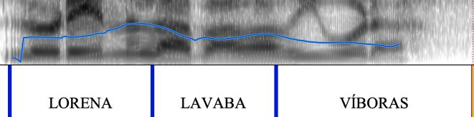
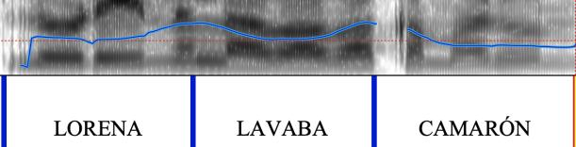
O
sSs sSs Sss
sSs sSs sSs
sSs sSs ssS

Slide 29
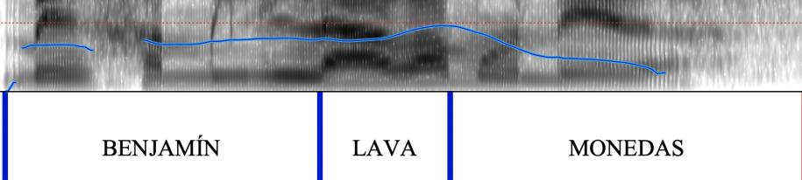
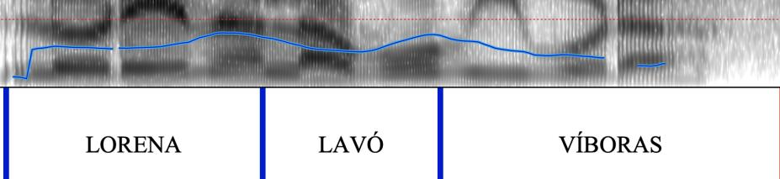
TONAL CROWDING
L+<H* L+<H*

Slide 30
FINDING INTONATIONAL CATEGORIES
Languages with lexical pitch specification → less tone variation at the post-lexical level
Word- or morphemic-specific tonal patterns
Accentual phrases: French, Korean, Lekeito Basque, Japanese
Lexical tone
Manipulation of pitch range, duration, intensity or voice quality
Languages with no word prosody
Jun & Fletcher (2014)

Slide 31
FINDING INTONATIONAL CATEGORIES
Next steps:
More sentence types
Different nuances within a category
Declarative: Lorena lavaba monedas
Wh-question: ¿Quién lavaba monedas?
Yes-no question: ¿Lorena lavaba monedas?
Imperative: ¡Lava monedas!
Request: ¿Podrías por favor lavar las monedas?
Jun & Fletcher (2014)

Slide 32
DECLARATIVES-FOCUS PROSODY
NEUTRAL FOCUS: Lorena lavaba monedas
INFORMATION FOCUS (Wh- questions)
CORRECTIVE FOCUS
¿Quién lavaba monedas?
LORENA lavaba monedas.
¿Qué lavaba Lorena?
Lorena lavaba MONEDAS.
¿Qué hacía Lorena?
Lorena LAVABA MONEDAS.
¿Qué hacía Lorena con las monedas?
Lorena LAVABA monedas.
¿Marina lavaba monedas?
No, LORENA lavaba monedas.
¿Lorena lavaba sábanas?
No, Lorena lavaba MONEDAS.
¿Lorena doblaba sábanas?
Lorena LAVABA MONEDAS.
¿Lorena robaba monedas?
No, Lorena LAVABA monedas.
Notes:
Explroing different nuances for a certain category

Slide 33
QUESTION INTONATION-POLAR QUESTIONS
Unbiased→ handout-situation (a)
Unexpected → handout-situation (b)
Negative answer expected → handout-situation (c)
Affirmative response expected → handout-situation (d)
In pairs, read the situations on the handout and compare your answers for each situation.

Slide 34
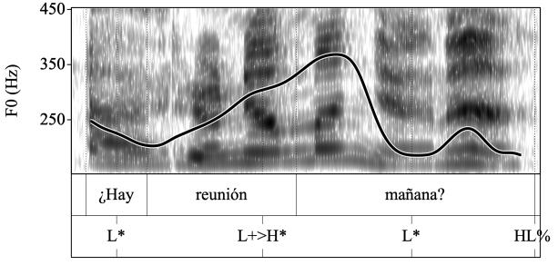
Armstrong (2017)

Slide 35
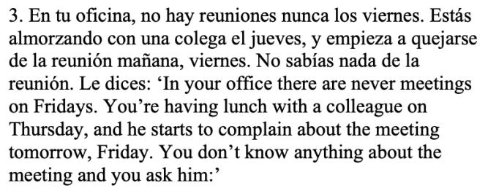
Armstrong (2017)
UNEXPECTED, INCREDULITY

Slide 36
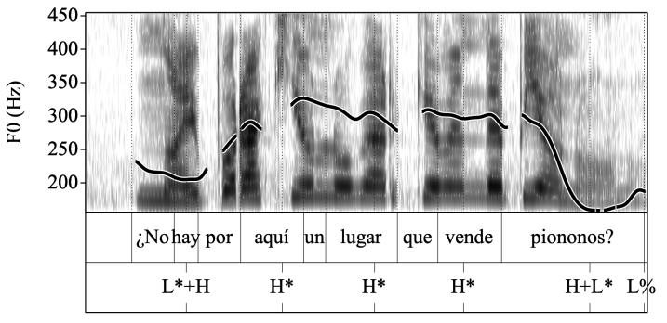
Armstrong (2017)

Slide 37
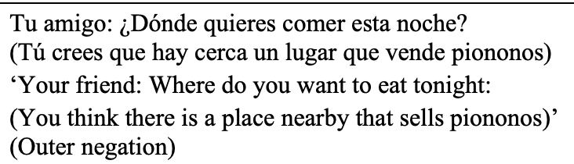
Armstrong (2017)
AFFIRMATIVE RESPONSE EXPECTED

Slide 38
EXAMINING THE PITCH TRACK

Slide 39
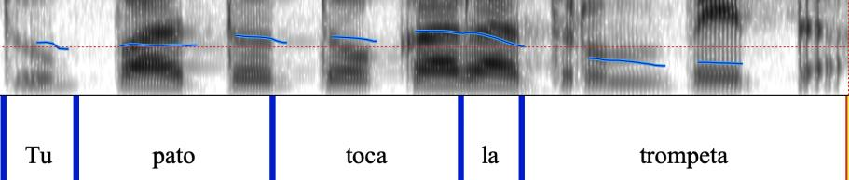
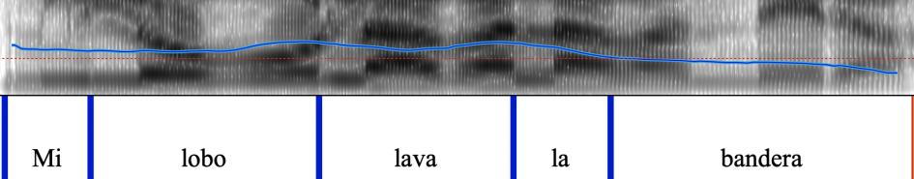
PITCH TRACK ERRORS
Roettger and Grice (2019)
Voiceless segments → No F0

Slide 40
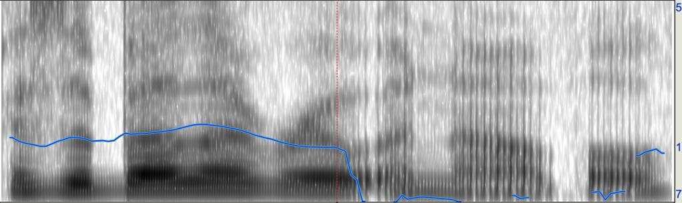
PITCH TRACK ERRORS
Gussenhoven (2004)
Creaky voice
Isabela wrote a novel

Slide 41
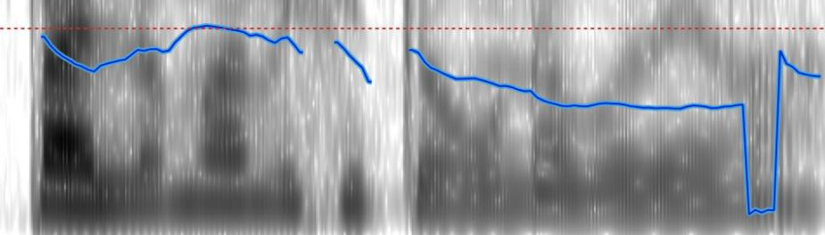
PITCH TRACK ERRORS
Gussenhoven (2004)
HALVING
DOUBLING
Overestimated F0
Underestimated F0
Paloma visitó una bodega

Slide 42
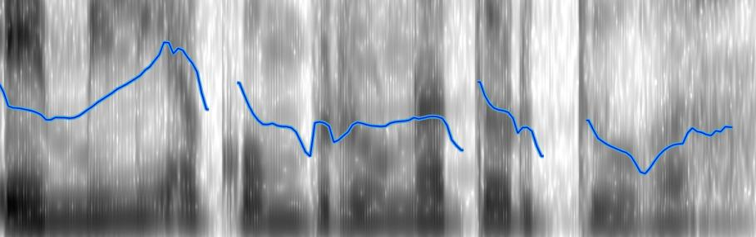
PITCH TRACK ERRORS
Gussenhoven (2004)
HALVING
DOUBLING
Overestimated F0
Underestimated F0
Emilio compró una tortuga

Slide 43
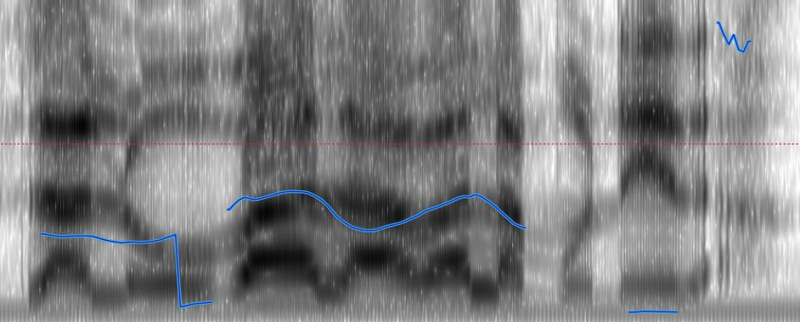
HALVING AND DOUBLING
Gussenhoven (2004)

Slide 44
PITCH TRACK ERRORS
Gussenhoven (2004)
MICROPROSODIC EFFECTS
F0-raising due to a preceding voiceless obstruent
Emilio compró una tortuga

Slide 45
PITCH TRACK ERRORS
Gussenhoven (2004)
MICROPROSODIC EFFECTS
F0-lowering due to a preceding voiced obstruent
Emilio compró una tortuga

Slide 46
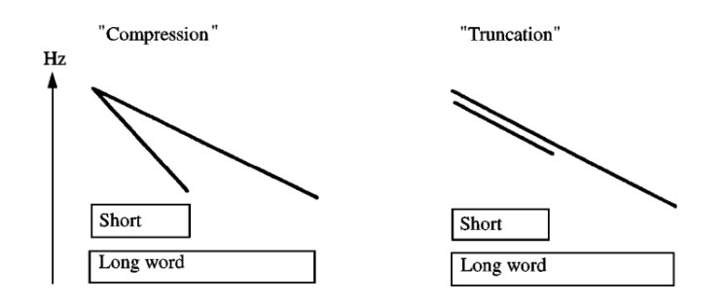
Grabe (1998), Roettger and Grice (2019)
May cause a loss of information and a weaker perceptual retrievability of the pragmatic contrast
Different F0 patterns need to be analyzed as realizations of a single phonological category.

Slide 47
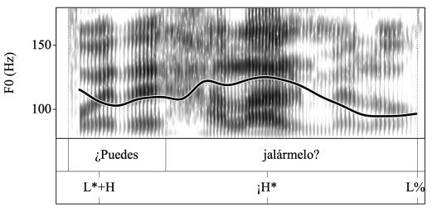
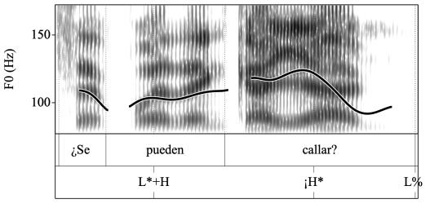
PR Spanish question intonation
Intonational contour:
¡H* L%
Compression example→
Armstrong (2017)

Slide 48
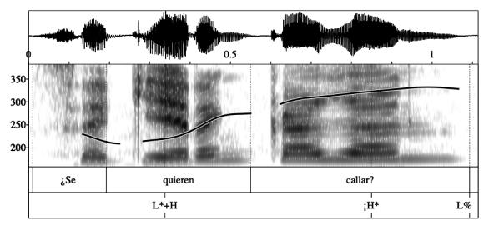
PR Spanish question intonation
Intonational contour:
¡H* L%
Truncation example →
Armstrong (2017)

Slide 49
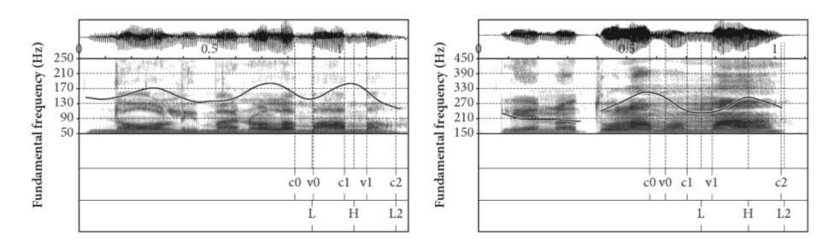
NARROW FOCUS IN CATALAN (AND SPANISH)
No, l’hi mano a la MAMÀ “No, I am asking this to MUM’
Compressed Truncated
Prieto and Ortega Llebaria (2009)

Slide 50
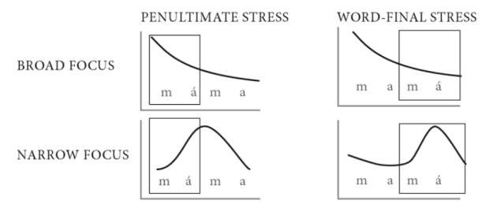
NARROW FOCUS IN CATALAN (AND SPANISH)
Complex contour (rise-fall) in narrow focus
→ Vowel lengthening for the contour to be fully realized
→ When truncated, no lengthening
Prieto and Ortega Llebaria (2009)

Slide 51
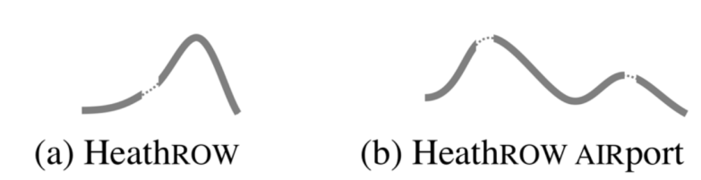
TONE SHIFTS
Tone shifts to avoid stress clash
Roettger, T. B., & Grice, M. (2019)

Slide 52
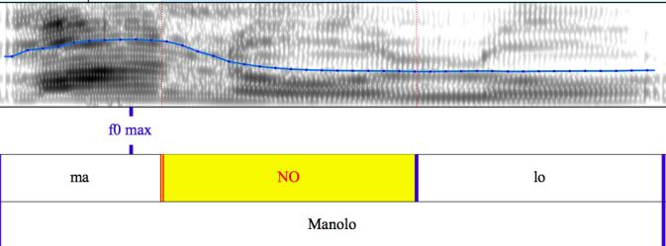
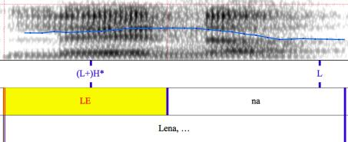
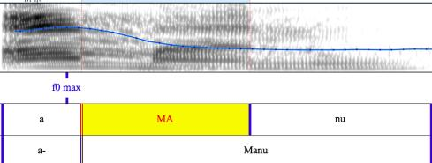
VOWEL INSERTION
H+L*
(L+)H*
H+L*

Slide 53

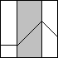
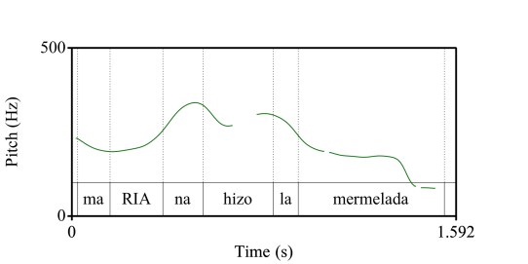

GRADIENT DIFFERENCES
F0 ALIGNMENT: The location of tonal events (e.g. F0 peaks) with respect to segments (e.g. the end of the stressed syllable)
Maximum F0
Maximum F0
L+<H*
L+H*

Slide 54




GRADIENT DIFFERENCES
TARGET HEIGHT/PITCH SCALING:
Maximum F0
H*
L+H*
Minimum F0

Slide 55

1
2
3
4
5
6
For each step, decide whether the statement sounds neutral (as in the answer to the question ¿Qué escucha?) or corrective (as in the answer to question ¿Escucha rancheras?)
7

Slide 56
Sp_TOBI

Slide 57
SPANISH ToBI SYSTEM
Spanish intonation has been well studied but we learn more with each dialect.
Categories are somewhat similar across Spanish dialects but there is of course some variation, especially in contact scenarios.

Slide 58
Discourse Completion Task (DCT)
Participants react to 69 controlled situations presented by the researcher in order to elicit different intonational contours based on a specific pragmatic meaning.
Different versions (adapted culturally and linguistically) were employed to collect data from different varieties of Spanish.
Castilian Spanish
Cantabrian Spanish
Canarian Spanish
Dominican Spanish
Puerto Rican Spanish
Venezuelan Andean Spanish
Ecuadorian Andean Spanish
Chilean Spanish
Argentinian Spanish
Mexican Spanish
Prieto, P.; Roseano, P. (eds.) (2010). Transcription of Intonation of the Spanish Language. Lincom Europa: München.
Prieto, Pilar & Roseano, Paolo (coords). 2009-2013. Atlas interactivo de la entonación del español. http://prosodia.upf.edu/atlasentonacion/.

Slide 59
Discourse Completion Task (DCT)
The goal of the DCT was to use not only sentence categories but varying meanings within those categories to try to elicit as many tunes as possible – these will vary by variety.
Vanrell, Feldhausen and Astruc (2018) review this method.
In your handouts, you have a selection of some of the situations used to elicit different intonational contours. Work in pairs or groups, pretending to be the interviewer or the interviewee.

Slide 60


Slide 61


Slide 62


Slide 63


Slide 64

DIALECTAL VARIATION

Slide 65








BROAD FOCUS STATEMENTS-1
1
2
3
4

Slide 66
BROAD FOCUS STATEMENTS-2
1
2
3
4

Slide 67
BROAD FOCUS STATEMENTS-3
1
2
3
4

Slide 68
BROAD FOCUS STATEMENTS-4
1
2
3
4

Slide 69





YES-NO QUESTIONS-1
1
2
3
4

Slide 70
YES-NO QUESTIONS-2
1
2
3
4

Slide 71
YES-NO QUESTIONS-3
1
2
3
4

Slide 72
YES-NO QUESTIONS-4
1
2
3
4

Slide 73
Sp_TOBI Revisions
Sp_ToBI Training materials (Aguilar, de la Mota, Prieto 2009):
http://prosodia.upf.edu/sp_tobi/en/
*Labels correspond to revisions previous to Hualde and Prieto (2015)
*Only Peninsular Spanish is represented.
Beckman et al (2002)
Hualde (2003)
Face and Prieto (2007)
Estebas-Vilaplana and Prieto (2009)
Prieto and Roseano (2010)
9 varieties
More individual studies on specific varieties
Hualde and Prieto (2015)

Slide 74








Not included in Hualde and Prieto (2015)
L+H* L+<H* L*+H
RISING PITCH ACCENTS
H+L*
FALLING PITCH ACCENT
H* L*
PLATEAUX
L+¡H* !H*
UPSTEPPED/DOWNSTEPPED

Slide 75




INTERMEDIATE PHRASE
BOUNDARY TONES
L- !H- H-
INTONATIONAL PHRASE BOUNDARY TONES
L% !H% H% LH% HL%

Slide 76
L* H%
L* L%
L+H* !H%
Vocative/Call
Neutral question
Declarative
Notes:
It is possible to identify some differences. In the vocative call, there is a rise in pitch that ends close to the edge of the stressed syllable followed by a falling tonal movement; in the neutral question, a relatively low pitch starts to rise in the final syllable; in the declarative, a sustained pitch starts falls also throughout the final syllable.

Slide 77



ToBI transcription systems:
Pitch accents
Boundary tones
L+H*
!H%
Vocative/Call
L*
H%
L*
Neutral question
L%
Cama vs. cana vs. caña
Declarative
Notes:
It is possible to identify some differences. In the vocative call, there is a rise in pitch that ends close to the edge of the stressed syllable followed by a falling tonal movement; in the neutral question, a relatively low pitch starts to rise in the final syllable; in the declarative, a sustained pitch starts falls also throughout the final syllable.

Slide 78
Tone Bearing Units (TBUs)
H%
H*
L%
L*
H%
L%
L+H*
L*
L%
H%
L+H*
L+H*

Slide 79
Pitch accent identification activities

Slide 80


Slide 81


Slide 82


Slide 83


Slide 84


Slide 85


Slide 86


Slide 87


Slide 88


Slide 89


Slide 90


Slide 91


Slide 92


Slide 93


Slide 94

L<H*

Slide 95
Boundary tone identification activities

Slide 96
L*

Slide 97

L+H*

Slide 98
L*

Slide 99

H+L*

Slide 100
L+H*

Slide 101
L+¡H*

Slide 102
INTERMEDIATE BOUNDARY TONES
After dislocated elements, before a right dislocated element, in narrow focus statements
Tonal movements at the end of intermediate phrases:
Enumerations
Continuation rise: non-finished statements
INTERMEDIATE PHRASE
BOUNDARY TONES
L- !H- H-

Slide 103
CHALLENGES

Slide 104

CHALLENGES
Interrater agreement scores
→ Cohen’s Kappa statistic: difference between the observed agreement and the expected agreement.
Armstrong (2017) from Viera and Garrett 2005, p. 362

Slide 105

DIALECTAL DIFFERENCES
De la Mota, Butragueño and Prieto (2010)

Slide 106



¿Afirmación o pregunta?
Asturias
[tjé.nes.meɾ.me.lá.ða]
Madrid
[tjé.ne.meɾ.me.lá.ða]
Notes:
As I mentioned earlier, even within the same language, there are differences between dialects, resulting in different form-meaning associations. Let’s consider the realization of neutral yes-no questions. The first example corresponds to a speaker from Madrid and the intonational contour is characterized by a final rise. This is the prototypical contour for a yes-no question in Spanish, and what we are taught or what we generally think of a question: the pitch has to rise at the end. However, in several dialects yes-no questions fall at the end. Speakers from other dialects or from other languages may fail to perceive the utterance as a question.

Slide 107

CROSS-LINGUISTIC DIFFERENCES
Estebas-Vilaplana (2014)

Slide 108


CROSS-LINGUISTIC DIFFERENCES
ToBI systems are language specific → The same label may be used to describe different tonal movements
Hualde and Prieto (2016)

Slide 109

International Prosodic Alphabet (IPrA)
Use of cross-linguistically transparent and consistent labels at the phonetic/surface level, to facilitate crosslinguistic comparisons.
→ Categories should be clearly defined in terms of scaling and alignment patterns
Hualde and Prieto (2016)

Slide 110

BILINGUAL SPEECH
Pre-nuclear rises:
Early peaks in Dutch
Late peaks in Greek
L1 DUTCH-L2 GREEK speakers→
0= end of the accented vowel
Mennen (2004)

Slide 111


L2 and BILINGUAL SPEECH
Perception of pre-nuclear alignment through a repetition task
*Mean normalized alignment values
LOW PROF.
HIGH PROF.
VERY HIGH PROF.
SPANISH NATIVES
ENGLISH NATIVES
BILINGUAL SPEAKERS
Early peaks Late peaks
Zárate-Sández (2015)

Slide 112
TOOLS
ETI_ToBI: Automatic transcription of intonation (Elvira-García, Roseano, Fernández Planas & Martínez Celdrán, 2016)
Create pictures script
More scripts del laboratorio de fonética de la Universidad de Barcelona

Slide 113



Drawing the pitch track on Praat picture

Slide 114



Drawing the pitch track on Praat picture

Slide 115
QUESTIONS? THOUGHTS?

Slide 116
PRACTICE
Get in groups.
One person records their answer for each of the four situations presented in the handout to elicit polar questions.
Compare the different contours: would you propose different nuclear configurations (final pitch accent and final boundary tone)? How many?

Slide 117
REFERENCES
Boersma, Paul & Weenink, David (2019). Praat: doing phonetics by computer [Computer program]. Version 6.1.05, retrieved 16 October 2019 from http://www.praat.org/
Aguilar, Lourdes; De-la-Mota, Carme; Prieto, Pilar (coords) (2009). Sp_ToBI Training Materials. Web page: http://prosodia.upf.edu/sp_tobi/
Armstrong, M. E. (2017). Accounting for intonational form and function in Puerto Rican Spanish polar questions. Probus, 29(1), 1-40.
Beckman, M. E., Díaz-Campos, M., McGory, J. T., & Morgan, T. a. (2002). Intonation across Spanish, in the Tones and Break Indices framework. Probus, 14(1), 9–36. https://doi.org/10.1515/prbs.2002.008
De la Mota, C., Butragueño, P. M., & Prieto, P. (2010). Mexican Spanish intonation. Transcription of intonation of the Spanish language, 319-350.
Elvira-García, W., Roseano, P.,Fernández Planas A. M. y Martínez Celdrán E. 2016. A tool for automatic transcription of intonation: Eti-ToBI a ToBI transcriber for Spanish and Catalan. Language Resources and Evaluation, 50(4),767-792.
Estebas-Vilaplana, E. (2014). The evaluation of intonation: Pitch range differences in English and in Spanish. In G. Thompson & L. Alba-Juez (Eds.), Evaluation in Context (pp. 179–193). Philadelphia, PA: John Benjamins Publishing Company.
Estebas-Vilaplana, E., & Prieto, P. (2009). La notación prosódica del español: una revisión del Sp_ToBI. Estudios de Fonética Experimental, 17, 264–283.
Face, T., & Prieto, P. (2007). Rising accents in Castilian Spanish: a revision of Sp_ToBI. Journal of Portuguese Linguistics, 6(1), 117–146.
Grabe, Esther. 1998. “Pitch Accent Realization in English and German.” Journal of Phonetics 26 (2): 129–143.
Gussenhoven, C. (2004). The Phonology of Tone and Intonation. Cambridge: Cambridge Univ Press.
Hualde, J. I. (2003). El modelo métrico y autosegmental. In P. Prieto (Ed.), Teorías de la entonación (pp. 155–184). Spain: Ariel.
Hualde, J. I., & Prieto, P. (2015). Intonational Variation in Spanish: European and American varieties. In S. Frota & P. Prieto (Eds.), Intonational variation in Romance (pp. 350–391). Oxford: Oxford University Press.
Hualde, J. I., & Prieto, P. (2016). Towards an International Prosodic Alphabet (IPrA). Laboratory Phonology, 7(1). https://doi.org/10.5334/labphon.11
Jun, S. A., & Fletcher, J. (2014). Methodology of studying intonation: From data collection to data analysis. Prosodic typology II: The phonology of intonation and phrasing, 493-519.
Mennen, I. (2004). Bi-directional interference in the intonation of Dutch speakers of Greek. Journal of Phonetics, 32(4), 543–563. https://doi.org/10.1016/j.wocn.2004.02.002
Pierrehumbert, J. (1980). The Phonetics and Phonology of English Intonation. Cambridge, MA: MIT Dissertation.
Prieto, P., & Ortega-Llebaria, M. (2009). Do complex pitch gestures induce syllable lengthening in Catalan and Spanish. Phonetics and phonology: Interactions and interrelations, 51-70.
Prieto, P.; Roseano, P. (eds.) (2010). Transcription of Intonation of the Spanish Language. Lincom Europa: München.
Roettger, T. B., & Grice, M. (2019). The tune drives the text: Competing information channels of speech shape phonological systems. Language Dynamics and Change, 9(2), 265-298.
Vanrell, M., Feldhausen, I., & Astruc, L. (2018). The Discourse Completion Task in Romance prosody research: Status quo and outlook. Methods in prosody: A Romance, 191.
Zárate-Sández, G. A. (2015). Perception and Production of Intonation among English-Spanish Bilingual Speakers at Different Proficiency Levels. Georgetown University.

Slide 118




BROAD FOCUS STATEMENTS
L+<H*
H*
L*
L%
L*+H
L*+H
H+L*
L%
H*
L+<H*
H+L*
L%
L+<H*
L*
L%

Slide 119




YES-NO QUESTIONS
L*+H
L*
LH%
L*+H
H*
H+L*
L-
H+L*
L%
L+H*
L+¡H*
HL%
L*+H
L*
HH%

